Slide 1
MTH 208: Calculus 2 Online Course Introduction
Professor Chad Vidden
Department of Mathematics and Statistics
University of Wisconsin - La Crosse

Slide 2
Course Introduction Outline
Online course design
My approach to online learning
Your role as an online student
Canvas website tour
Course instructions and details
Submitting assignments and timelines
How to succeed this course
Covid19 and online course considerations
Same expectations as in-person learning
Flexibility to student circumstances

Slide 3
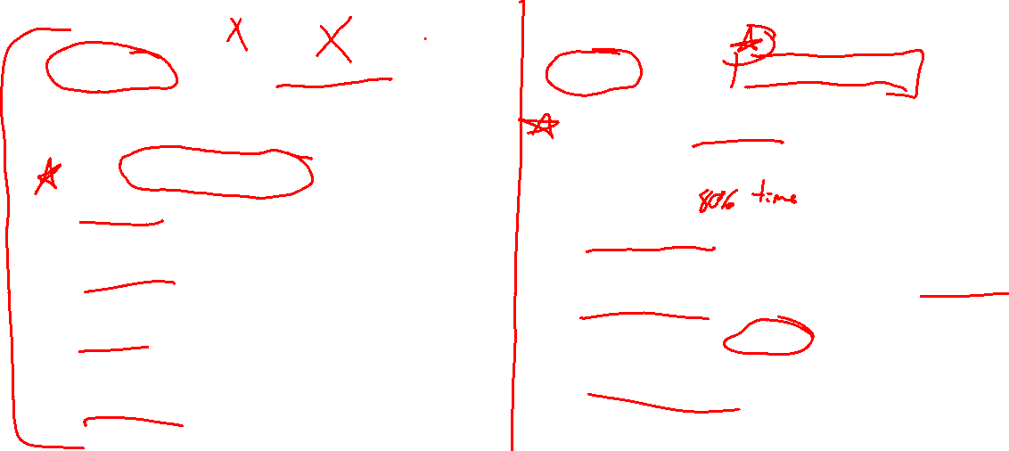
In-person vs Online Course Design
In-person Course (math skills focus)
Online Course (self-study skills focus)
Interactive lectures with student input and activities
No homework due
Quizzes each week, timed, no calculator or book
4 exams, 1 final exam, timed, no calculator or book
Final comprehensive exam
HW student groups and applied projects
Pre-recorded lectures with student activities on own
Structured homework due for each section
Self-graded quizzes each week
Self-proctored exams, also graded by instructor
Final exam activity
Project on own
Notes:
In person version already challenging in pace / content.
Online version is someswhat simplified in requirements, but content aspiration is the same.

Slide 4

Canvas Website Tour
Syllabus
Lectures
Homework, Quizzes, Exams, Project
Honor code of conduct
Questions and discussion boards
Virtual office hours
Tutoring resources

Slide 5
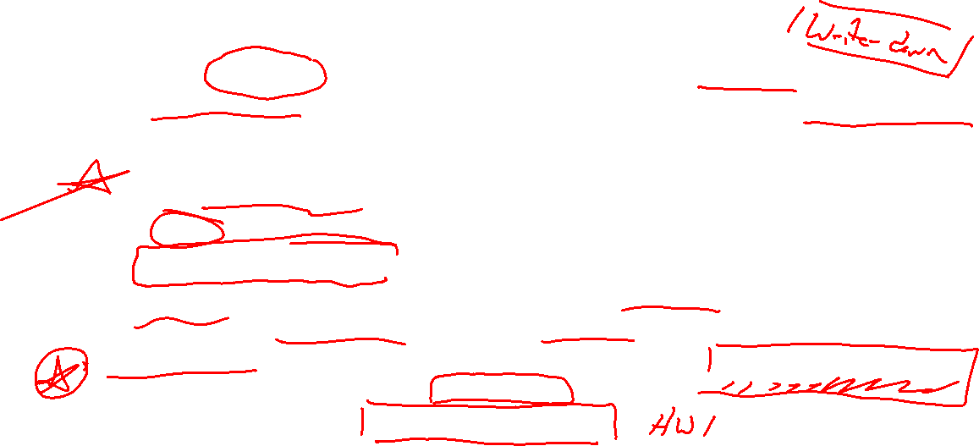
How to Succeed In this Course
Create a schedule for yourself for this course and stick to it
~ 10 hours per week, note of specific days and times, treat as an in-person course.
Keep on track with deadlines
It is easy to fall behind with weekly deadlines, work ahead if possible.
I will check in with you if you are falling behind.
Put effort into homework activities (most important part of this course)
Be honest with yourself regarding what you do and don't understand
Get help right away if you feel lost or overwhelmed
Attend virtual office hours or tutoring, email me with any questions or concerns.
Opportunity to learn self-study skills to become an independent learner
Important skill not taught in most courses.
Provide course to me feedback via surveys

Slide 6

Covid 19 and Online Learning Considerations
I recognize this is a diﬃcult time for every student in this course, and some students may be operating under additional constraints compared to normal semesters.
I will be understanding and ﬂexible of individual student circumstances regarding course deadlines.
Reach out to me if you are struggling to keep up. I will do everything I can to help you.

